Slide 1
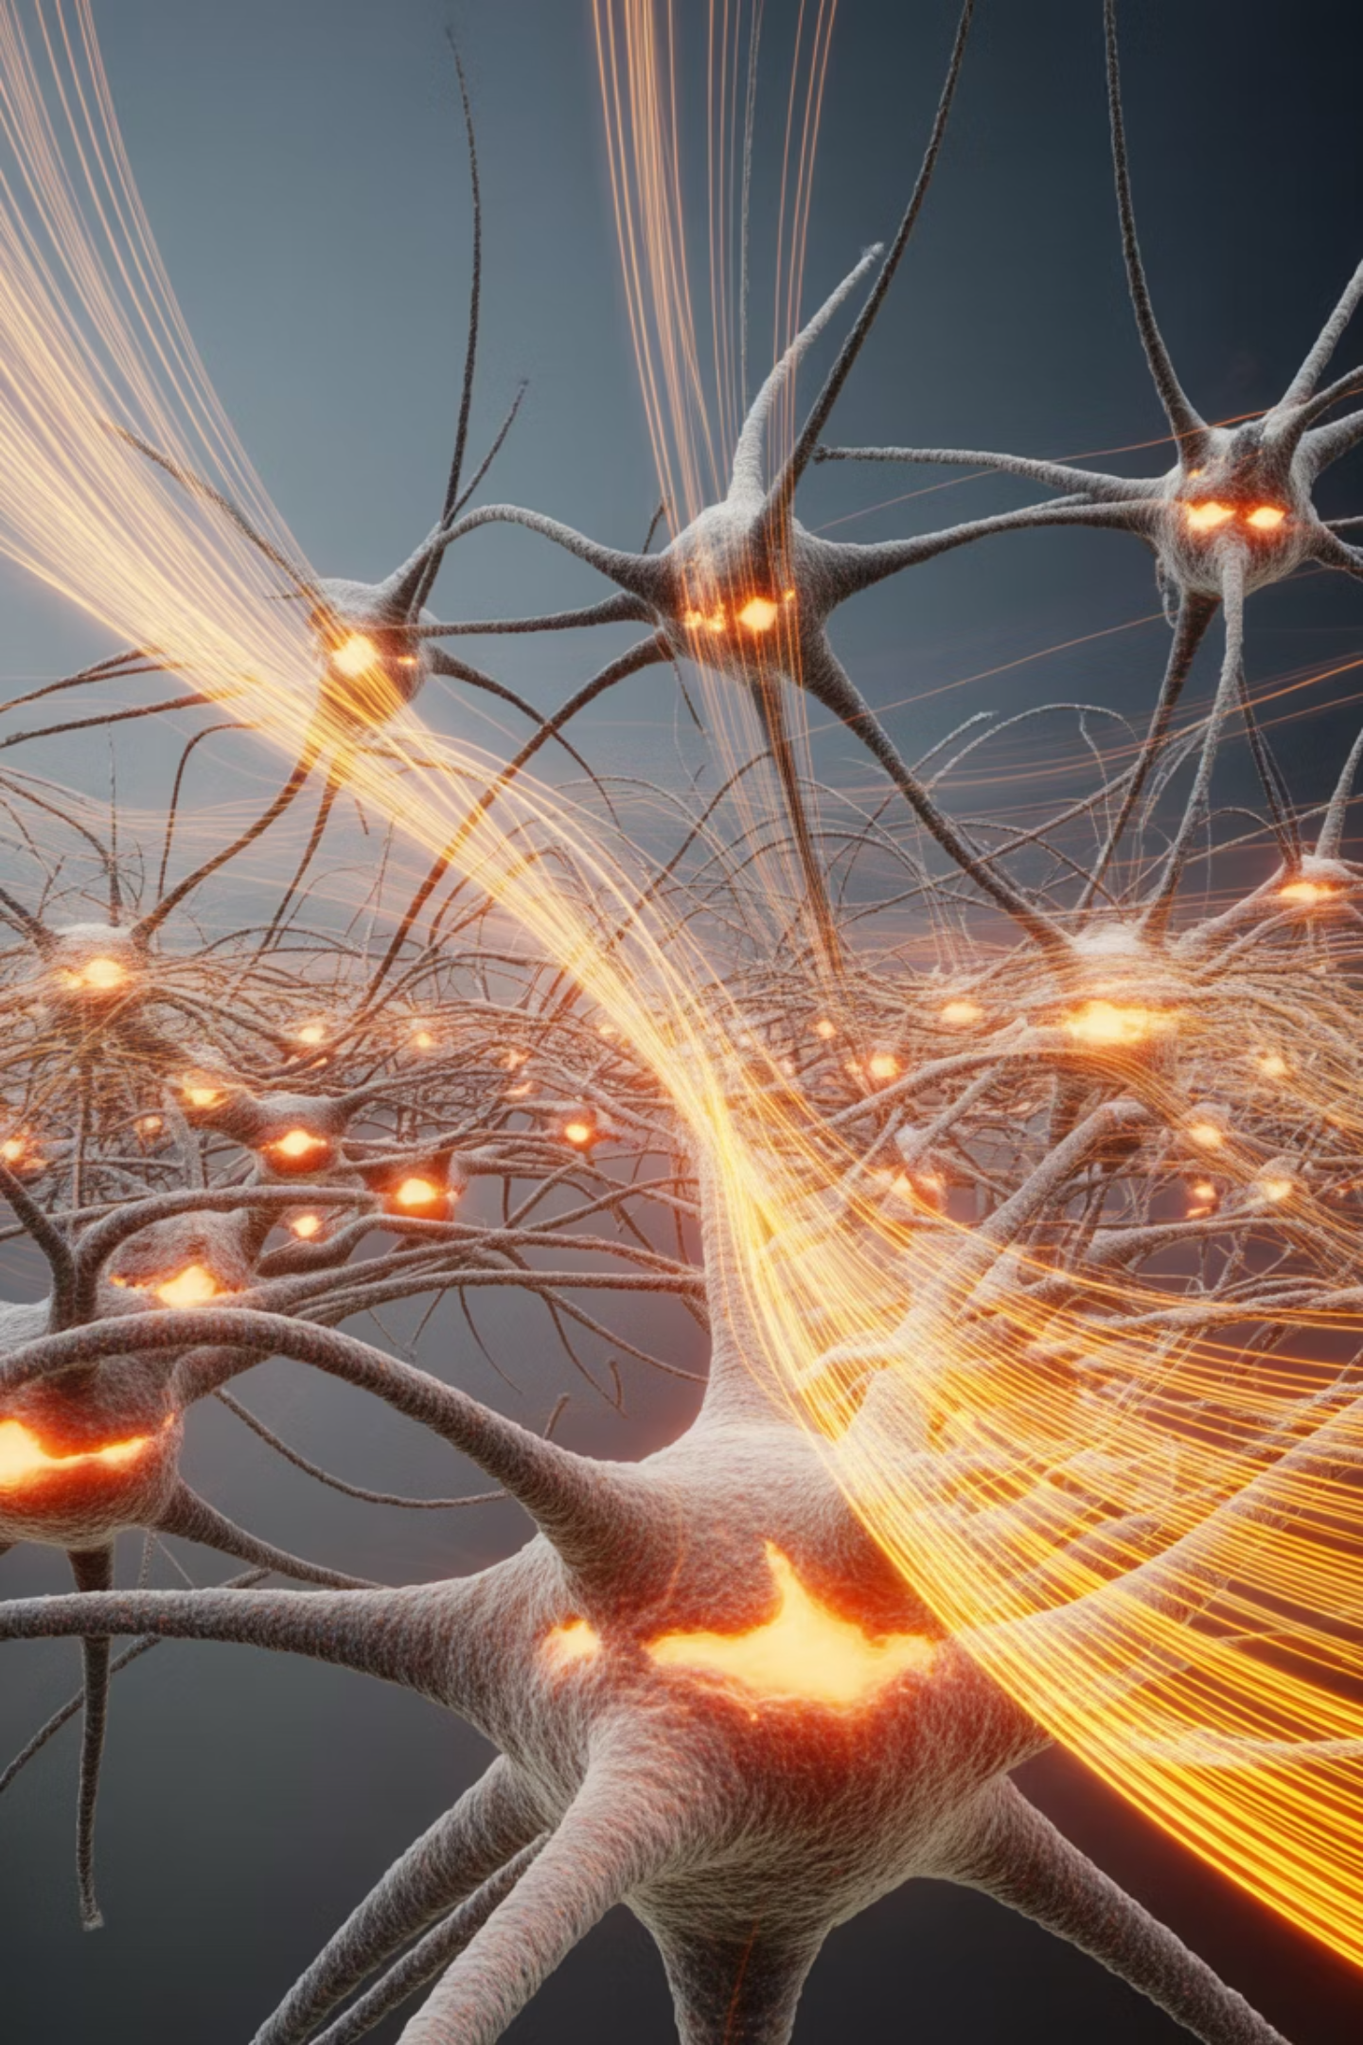
Introduction to Machine Learning
Understanding ML Fundamentals, Methods, and Applications in Modern Systems

Slide 2
Contents
01
02
What is Machine Learning
Core Components Of ML
03
04
Rule-based Vs. ML Systems
Supervised Learning
05
06
Unsupervised/Semi-supervised Learning
Reinforcement Learning
07
08
Classical Statistics vs. ML
Machine Learning vs Deep Learning

Slide 3
What is Machine Learning?
Machine Learning (ML) is a branch of Artificial Intelligence that enables computers to learn patterns from data and continuously improve their performance on specific tasks without being explicitly programmed for every possible rule or scenario.
Formal Definition: Machine Learning gives computers the ability to learn from experience (E) to perform a task (T) and improve performance (P) over time through pattern recognition and statistical inference.
This paradigm shift moves us from static, rule-based programming to dynamic, adaptive systems that evolve with exposure to new data.
ML systems can identify complex patterns that would be nearly impossible for humans to code manually, making them invaluable for modern business and technical applications.

Slide 4
Core Components of Machine Learning Systems
Data
Historical examples and observations that serve as the foundation for learning. Quality and quantity of data directly impact model performance.
Optimization
Optimization techniques like Gradient Descent that iteratively improve the model's accuracy through systematic parameter adjustments.
Model
Mathematical structure designed to learn and represent patterns. Acts as the pattern-recognition engine of the system.
Evaluation Metrics
Performance measures including accuracy, Mean Squared Error (MSE), and Area Under Curve (AUC) that quantify model effectiveness.
Practical Example: A spam filter learns from thousands of labeled emails (spam/not spam) to identify patterns in word usage, sender behavior, and message structure, continuously improving its detection accuracy with each new example.

Slide 5
Rule-Based Systems: The Traditional Approach
How They Work
Rule-based systems rely on fixed rules written by domain experts who manually encode business logic and decision criteria. These systems follow predetermined conditional statements to make decisions.
Credit Card Fraud Example
If foreign transaction AND amount > Euro 50,000 → block transaction
If more than 3 failed PIN attempts → decline card
If unusual merchant category → flag for review
Limitations
1. Inability to Adapt: Cannot learn from new fraud techniques or evolving patterns without manual rule updates.
2. False Positives: Rigid rules generate high false alerts, blocking legitimate customers and damaging user experience.
3. Maintenance Burden: Managing thousands of interconnected rules becomes exponentially complex and error-prone as systems scale.
4. Limited Pattern Detection: Can only capture simple, explicitly programmed logic—missing subtle or complex fraud indicators.

Slide 6
Machine Learning Systems: The Modern Solution
Machine Learning systems represent a fundamental shift in how we build intelligent applications. Rather than encoding explicit rules, these systems learn fraud patterns directly from historical transaction data, enabling sophisticated detection capabilities.
Pattern Learning
Automatically identifies unusual behaviors including sudden spending pattern changes, transactions from risky merchant categories, and device/IP mismatches without manual programming.
Subtle Detection
Captures complex, non-linear relationships and emerging fraud techniques that would be invisible to rule-based systems.
Continuous Improvement
Models evolve with each new transaction, learning from both successful detections and false positives to refine accuracy over time.
Enhanced Experience
Dramatically reduces false positives, allowing legitimate transactions to proceed smoothly while catching genuine fraud more effectively.

Slide 7
Comparative Analysis: Rules vs Machine Learning
Feature | Rule-Based Systems | Machine Learning Systems
Knowledge Source | Human-written rules and expert logic | Data-driven pattern discovery
Adaptability | Very low—requires manual updates | High—learns continuously from new data
Pattern Detection | Simple conditional logic only | Complex non-linear relationships
Maintenance Cost | High and increasing with complexity | Scalable with automated retraining
Business Value | Limited to known scenarios | Strong ROI through continuous optimization
Response to Change | Slow—weeks or months for updates | Fast—adapts with new training cycles
The transition from rule-based to ML systems represents not just a technical upgrade but a strategic business advantage, enabling organizations to respond dynamically to evolving challenges and opportunities.

Slide 8
Supervised Learning: Learning from Labeled Examples
Supervised Learning is the most widely used ML paradigm, where models learn from data that has been labeled with correct answers. The algorithm learns to map inputs to outputs by studying these labeled examples.
Classification Tasks
Predicting discrete categories or classes from input features.
Email spam detection (spam/not spam)
Medical diagnosis (disease present/absent)
Customer churn prediction (will leave/will stay)
Image recognition (cat/dog/bird)
Regression Tasks
Predicting continuous numerical values from input features.
House price prediction
Stock market forecasting
Temperature estimation
Sales revenue projection
Common Algorithms
Linear Regression • Logistic Regression • K-Nearest Neighbors (KNN) • Support Vector Machines (SVM) • Decision Trees • Random Forest • Neural Networks

Slide 9
Unsupervised and Semi-Supervised Learning
Unsupervised Learning
Discovers hidden patterns and structures in unlabeled data without predefined categories or outcomes. The algorithm identifies natural groupings and relationships autonomously.
Key Tasks:
Clustering: Customer segmentation, market basket analysis, document grouping
Dimensionality Reduction: Data compression, feature extraction (PCA, t-SNE)
Anomaly Detection: Identifying unusual patterns or outliers
Algorithms: K-Means, Hierarchical Clustering, DBSCAN, Principal Component Analysis
Semi-Supervised Learning
Combines a small amount of labeled data with a large volume of unlabeled data, leveraging the structure in unlabeled data to improve learning efficiency when labeling is expensive or time-consuming.
Ideal Applications:
Medical image analysis (few expert-labeled scans)
Web content classification (limited manual categorization)
Speech recognition (expensive transcription process)
This approach significantly reduces labeling costs while achieving performance close to fully supervised methods.

Slide 10
Reinforcement Learning: Learning Through Experience
Reinforcement Learning (RL) represents a fundamentally different learning paradigm where an agent learns optimal behavior through trial and error, receiving rewards or penalties based on its actions. Unlike supervised learning, there are no labeled examples—the agent must discover which actions yield the highest rewards.
State
Current situation or environment the agent observes
Reward
Feedback signal indicating action quality
Action
Decision or move the agent makes in response
Learning
Agent adjusts strategy to maximize cumulative rewards
Real-World Applications
Robotics: Teaching robots to navigate, manipulate objects, and perform complex tasks
Autonomous Vehicles: Self-driving cars learning optimal driving strategies
Game Playing: AlphaGo defeating world champions through self-play
Resource Management: Optimizing energy consumption, network routing, and inventory control

Slide 11
ML Method Categories and Common Algorithms
Category | Representative Algorithms | Primary Use Cases
Supervised Learning | Linear Regression, Logistic Regression, SVM, KNN, Decision Trees, Random Forest, Gradient Boosting, Neural Networks | Prediction and classification with labeled data
Unsupervised Learning | K-Means Clustering, Hierarchical Clustering, PCA, t-SNE, DBSCAN, Autoencoders | Pattern discovery and data exploration
Semi-Supervised | Self-Training, Co-Training, Label Propagation, Generative Models | Learning with limited labeled data
Reinforcement Learning | Q-Learning, Deep Q Networks (DQN), Policy Gradients, Actor-Critic, Monte Carlo Methods | Sequential decision-making and optimization
Algorithm selection depends on problem type, data characteristics, interpretability requirements, and computational resources available. Often, practitioners experiment with multiple approaches to identify the best-performing solution.

Slide 12
Classical Statistics vs Machine Learning
Aspect | Classical Statistics | Machine Learning
Primary Goal | Explanation, inference, and understanding relationships | Accurate prediction on unseen data
Data Requirements | Works with small to medium datasets | Thrives on large datasets
Underlying Assumptions | Strong assumptions about data distribution and relationships | Minimal assumptions—let data reveal patterns
Interpretability | High—clear understanding of variable relationships | Often low—"black box" models
Core Focus | Understanding why relationships exist | Optimizing performance on future predictions
Typical Questions | "Why does X affect Y?" "Is this relationship significant?" | "What will happen next?" "How accurate can we predict?"
Key Insight: Statistics answers "Why?" while Machine Learning answers "What will happen?" Both approaches are valuable and often complementary in business analytics.

Slide 13
Real-World Case Studies
Case Study 1: Diabetes Prediction
Problem: Early identification of individuals at high risk for diabetes to enable preventive interventions.
Input Features: Patient age, fasting glucose levels, BMI, blood pressure, family history, physical activity levels, and dietary habits.
ML Approach: Logistic Regression and Random Forest models trained on historical patient data with known diabetes outcomes.
Business Impact: Healthcare providers can conduct targeted early screenings, recommend lifestyle modifications, and allocate preventive care resources more effectively, reducing long-term treatment costs and improving patient outcomes.
Case Study 2: Telecom Churn Prediction
Problem: Identifying customers likely to cancel their service subscriptions before they leave.
Input Features: Call patterns, data usage, customer service interactions, contract details, payment history, and demographic information.
ML Approach: Classification models including Gradient Boosting and Neural Networks to predict churn probability for each customer.
Business Impact: Telecommunications companies can design targeted retention strategies, offer personalized incentives to at-risk customers, and reduce customer acquisition costs by preventing churn—significantly improving customer lifetime value and revenue stability.

Slide 14
The Machine Learning Workflow Pipeline
1. Problem Definition
Clearly articulate the business problem, success metrics, and constraints. Define what constitutes a successful model.
3. Data Cleaning & Preprocessing
Handle missing values, remove duplicates, address outliers, and transform data into usable formats.
5. Model Selection & Training
Choose appropriate algorithms, split data into training/validation/test sets, and train candidate models.
7. Model Evaluation
Assess model performance using appropriate metrics, validate on held-out test data, and ensure generalization.
2. Data Collection
Gather relevant data from databases, APIs, sensors, or other sources. Ensure data quality and sufficient volume.
4. Feature Engineering
Create meaningful features from raw data, select relevant variables, and transform features to improve model performance.
6. Hyperparameter Tuning
Optimize model parameters using techniques like grid search or Bayesian optimization to maximize performance.
8. Deployment & Monitoring
Deploy model to production environment, monitor performance over time, and retrain as needed to maintain accuracy.
This iterative pipeline is essential for successful real-world ML implementation, requiring collaboration between data scientists, engineers, and business stakeholders.

Slide 15
Machine Learning vs Deep Learning
Traditional Machine Learning
Feature Engineering: Requires manual feature extraction and selection by domain experts.
Data Requirements: Works effectively with small to medium-sized datasets (thousands to hundreds of thousands of examples).
Computational Needs: Runs efficiently on standard CPUs without specialized hardware.
Interpretability: Models like Decision Trees and Linear Regression offer clear explanations of predictions.
Optimal Use Cases: Structured tabular business data, problems with limited training examples, scenarios requiring model transparency.
Deep Learning
Feature Engineering: Automatically learns relevant features from raw data through multiple processing layers.
Data Requirements: Requires very large datasets (millions of examples) to achieve optimal performance.
Computational Needs: Demands powerful GPUs or TPUs for efficient training and inference.
Interpretability: Often operates as "black boxes" with limited transparency into decision-making processes.
Optimal Use Cases: Unstructured data including images, audio, video, and natural language—excels at complex pattern recognition tasks.
Deep Learning is a powerful subset of Machine Learning, leveraging neural networks with multiple layers to automatically discover intricate patterns in large-scale unstructured data.

Slide 16
Key Takeaways: Machine Learning Fundamentals
2. Four Major Paradigms
Supervised Learning (labeled data), Unsupervised Learning (pattern discovery), Semi-Supervised Learning (hybrid approach), and Reinforcement Learning (reward-based) address different problem types and data availability scenarios.
3. Prediction vs Inference
Machine Learning prioritizes accurate predictions on unseen data, while Classical Statistics focuses on explaining relationships and testing hypotheses—both approaches offer complementary value.
Data-Driven Intelligence
Machine Learning enables systems to make intelligent decisions by learning patterns from data rather than following rigid programmed rules, providing adaptability and continuous improvement.
4. Deep Learning Revolution
Deep Learning excels with big data and complex patterns in unstructured formats (images, text, audio), but traditional ML remains highly effective for structured business data with smaller datasets.
5. Systematic Implementation
Successful ML projects follow a structured workflow from problem definition through deployment and monitoring, requiring cross-functional collaboration and iterative refinement.
Machine Learning transforms how organizations leverage data to solve complex problems, creating adaptive systems that improve over time and deliver measurable business value.

